Slide 1
Science of Living System
BS20001
Arindam Mondal
School of Bioscience
Email: arindam.mondal@iitkgp.ac.in
Tel: 03222-260518

Slide 2
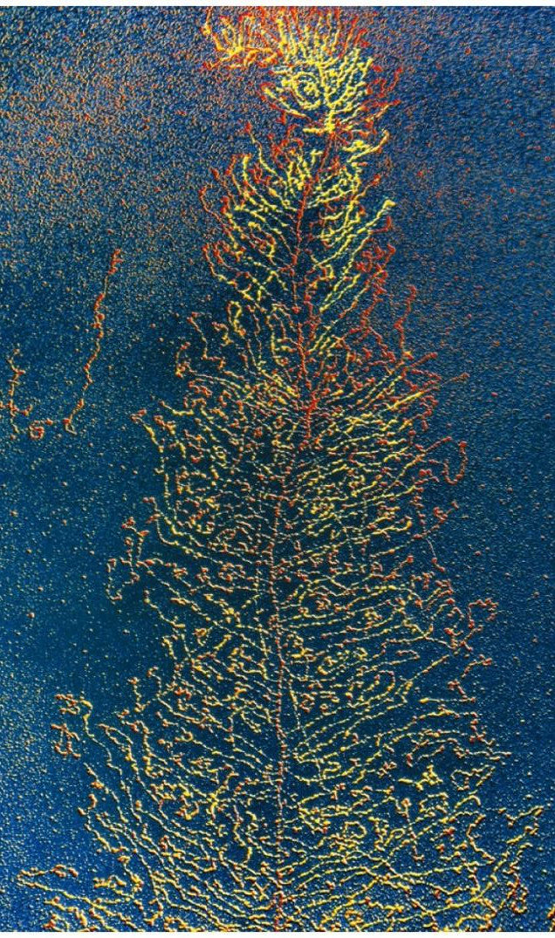
Overview of Transcription and Translation

Slide 3
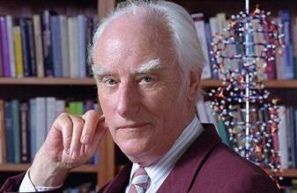
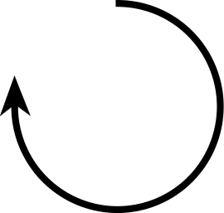
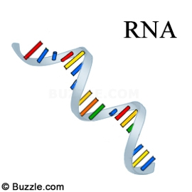
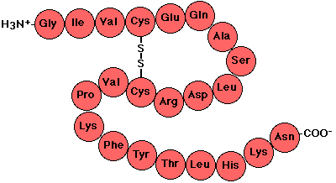
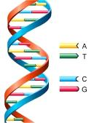
Flow of Genetic Information: The Central Dogma of Molecular Biology
DNA Polymerase
RNA Polymerase
Nobel Prize in 1962 for DNA Structure
Ribosome
DNA
RNA
Protein
Transcription
Translation
Replication
DNA
RNA
Protein
Polymer of nucleotides
Polymer of nucleotides
Polymer of amino acids

Slide 4
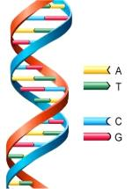
Correlations Between DNA Content and Its Down-stream Product
Transcription
Translation
DNA
RNA
Protein

Slide 5
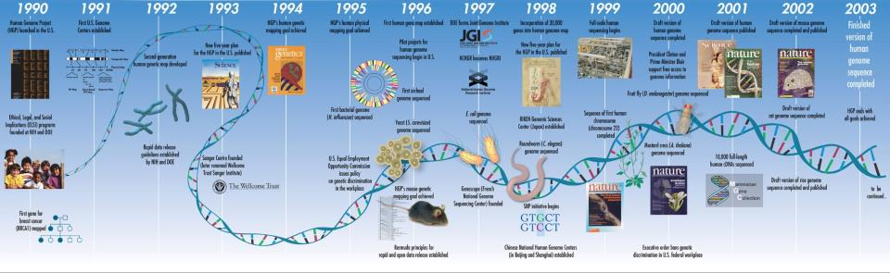
“Human Genome Project” dramatically enhanced our understanding of Gene Expression
∼21,000 human genes (appeared to be significantly fewer than previous estimates)
Notes:
The Human Genome Project (HGP) was an international scientific research project with the goal of determining the sequence of nucleotide base pairs that make up human DNA, and of identifying and mapping all of the genes of the human genome from both a physical and a functional standpoint.^{[1]} It remains the world's largest collaborative biological project.^{[2]} After the idea was picked up in 1984 by the US government when the planning started, the project formally launched in 1990 and was declared complete in 2003. Most of the sequencing was performed in twenty universities and research centers in the United States, the United Kingdom, Japan, France, Germany, Canada, and China
After publication of the report of HGP in 2002, Francis Collins, the director of NHGRI, noted that the genome could be thought of in terms of a book with multiple uses: "It's a history book - a narrative of the journey of our species through time. It's a shop manual, with an incredibly detailed blueprint for building every human cell. And it's a transformative textbook of medicine, with insights that will give health care providers immense new powers to treat, prevent and cure disease.”
Book written by Francis Collins: Language of God

Slide 6
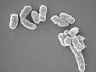
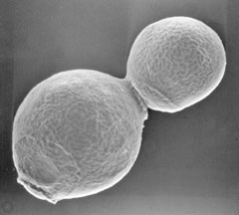
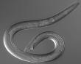
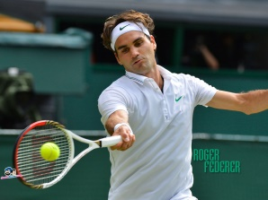
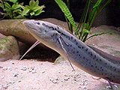
Genome Size, Gene Number, and Complexity of an Organism
Organism Genome size (bp) Protein coding genes
E. coli 4,600,000 4,250
S. cerevisiae 12,160,000 5,616
C. elegans 100,000,000 19,735
Human 3,200,000,000 21,000
Marbled lungfish 139,000,000,000 NA

Slide 7
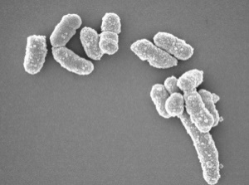
Transcription
Genome size (bp)
Total DNA content vs transcribable content
4,600,000
3,200,000,000
►Protein coding sequences is ~1.5% of total DNA content (human)
Messenger RNA (mRNA)
►Besides protein coding region, DNA can be transcribed into:
Ribosomal RNA (rRNA)
Transfer RNA (tRNA)
►Most of the DNA sequences are not transcribed

Slide 8
What is a machine?
A piece of equipment with several moving parts that uses power to do a particular type of work.
Cambridge dictionary
Biological machines:
DNA polymerase
RNA polymerase
Ribosome

Slide 9
Transcription: Involved Machineries and Processes
Promoter
Start
Stop
gene
Key points to be discussed
Promoter
RNA Polymerase
RNA synthesis
Termination
RNA Polymerase
5’
3’
3’
5’
5’
Initiation
Elongation
Termination
3’
5’
Nascent mRNA

Slide 10
Promoter for Transcription
Promoter is just like a “pointer” that points to the location of the information (gene) to be copied into mRNA
-10
+1
Coding strand
5’
TATAAT
ATTGCGATGG
3’
Template strand
3’
Promoter
TAACGCTACC
5’
5’
3’
Prokaryotic promoter
AUUGCGAUGG
-25
+1
Coding strand
5’
TATAAA
AGTGCTATGG
3’
Template strand
3’
TATA box
(Promoter)
TCACGATACC
5’
Eukaryotic promoter

Slide 11
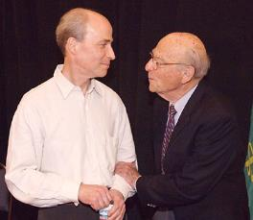
RNA Polymerase
Subunits of RNA Polymerase: α, α, β, β’ and σ
Holo-enzyme: α, α, β, β’ and σ
Core-enzyme: α, α, β and β’
β’
gene
β
σ
Roger Kornberg
Nobel Prize in 2006
α
α
►RNA polymerase is completely Processive: A transcript is synthesized from start to end by a single RNA polymerase molecule.
σ
►RNA polymerase can initiate the synthesis of RNA de-novo (No primer required)
RNA Molecules in E. coli
Who transcribes this huge pool of rRNA and tRNA?
mRNA 5%
tRNA 15%
rRNA 80%
In bacteria same RNA polymerase transcribe all these three types of RNA
In eukaryotes different RNA polymerases are involved in transcription of mRNA, rRNA and tRNA

Slide 12
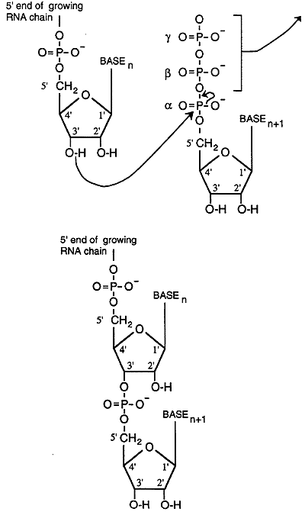
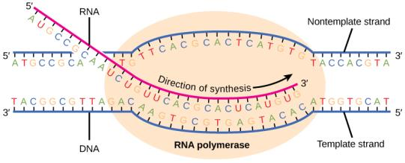
RNA Synthesis
Growing RNA chain
Coding strand
5’
+
3’
Ribonucleotide

Slide 13
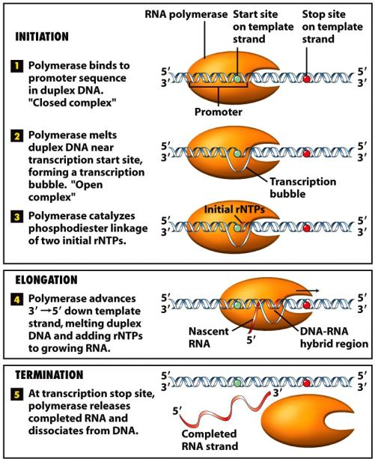
Schematic Representation of Multiple Steps Involved in Transcription

Slide 14
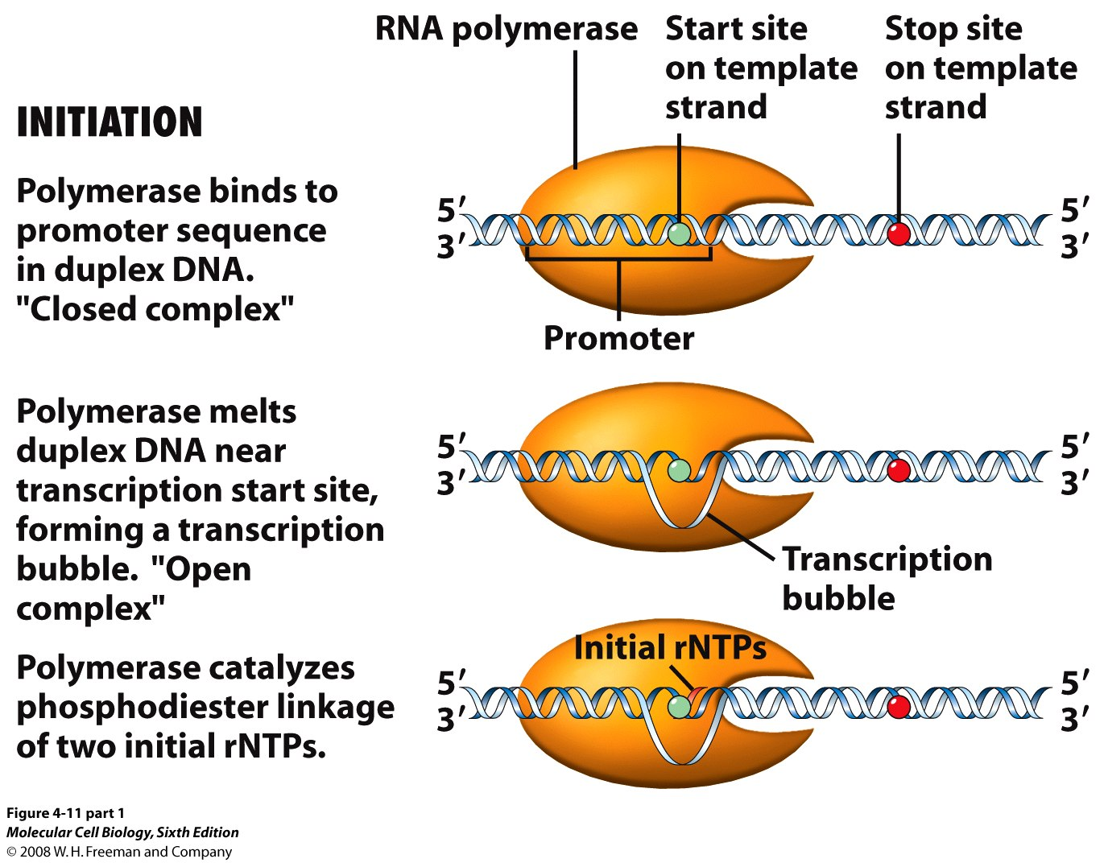
Schematic Representation of Multiple Steps Involved in Transcription

Slide 15
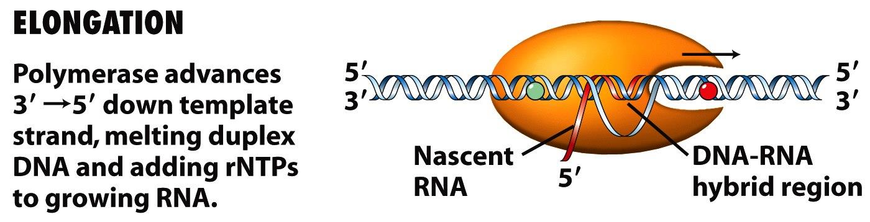
Schematic Representation of Multiple Steps Involved in Transcription

Slide 16
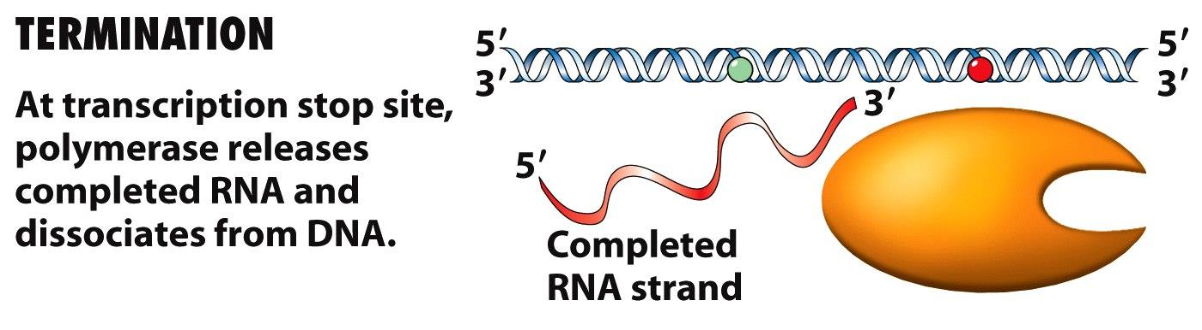
Schematic Representation of Multiple Steps Involved in Transcription

Slide 17
Termination of Transcription in Prokaryotes
An RNA hairpin followed by several uracil residues terminates transcription
Rho binds the nascent RNA chain and pulls it away from RNA polymerase and the DNA template.
Hairpin
(Stem-loop structure)
5’
3’
3’
5’
Rho protein
5’
3’
5’
Stryer, Biochemistry, 4th edition
Notes:
In vitro transcription of many genes yield much larger RNA than expected…. (rho absent in invitro transcription system)

Slide 18
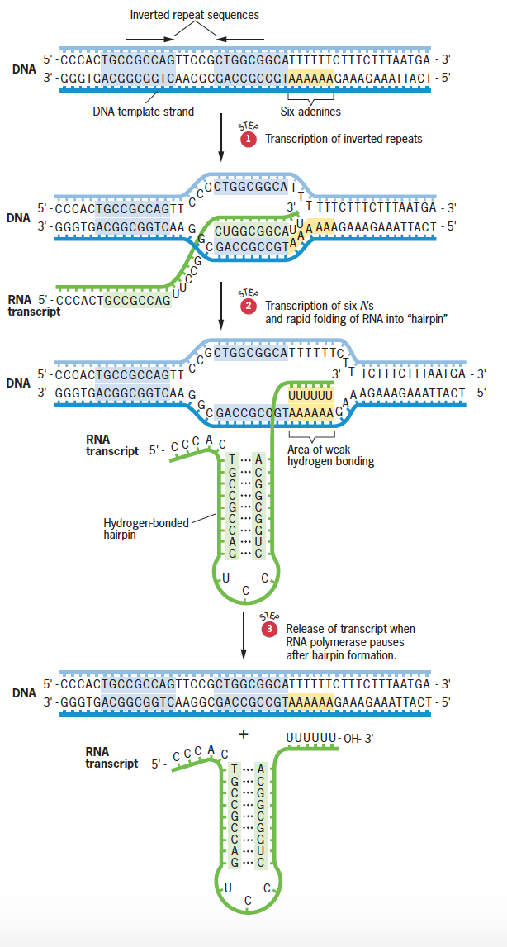
Termination of Transcription in Prokaryotes
Factor independent
An RNA hairpin followed by several uracil residues terminates transcription
Snustad, Principles of genetics, 6th Edition
Notes:
In vitro transcription of many genes yield much larger RNA than expected…. (rho absent in invitro transcription system)

Slide 19
Termination of Transcription in Prokaryotes
Factor dependent
Rho binds the nascent RNA chain and pulls it away from RNA polymerase and the DNA template.
5’
3’
3’
5’
Rho protein
5’
Stryer, Biochemistry, 4th edition

Slide 20
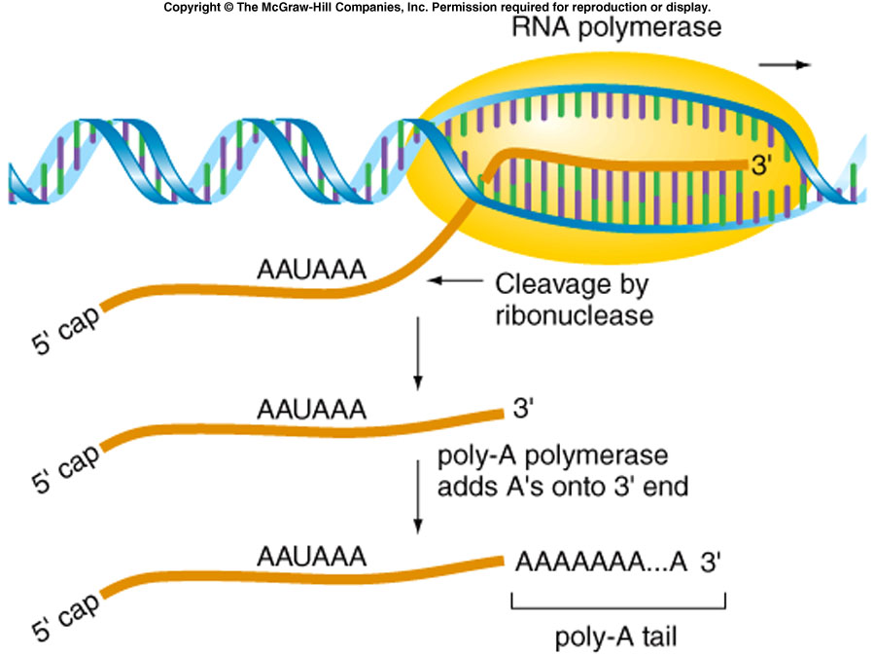
Eukaryotic Transcripts Need to be Processed
►Ends of a nascent mRNA acquire a 5’ cap and a 3’ poly A tail
●Increase stability of mRNA
●More effective template for translation

Slide 21
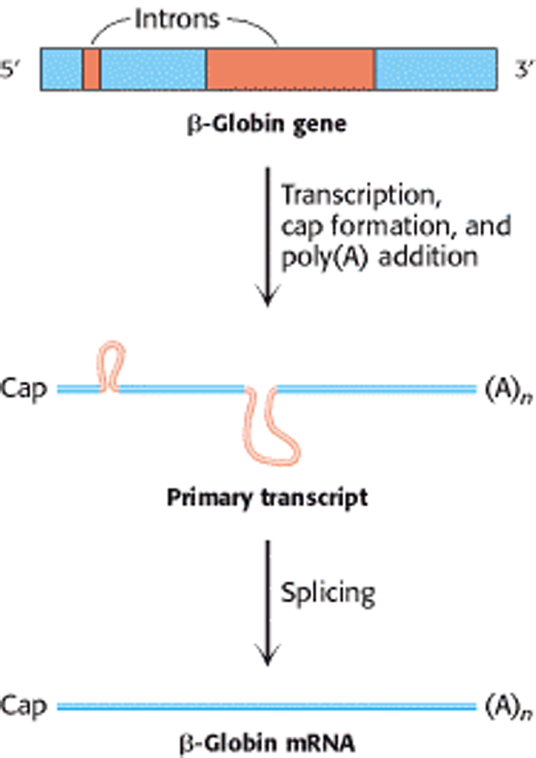
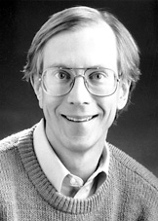
Eukaryotic Transcripts Need to be Processed
►Splicing (mediated by specialized enzymatic machineries consisting of snRNAs and proteins) removes introns from nascent mRNA
β-Globin gene
Transcription
Cap formation
Poly(A) addition
Thomas Cech
Nobel prize in 1989
Primary transcript
Splicing
β-Globin mRNA

Slide 22
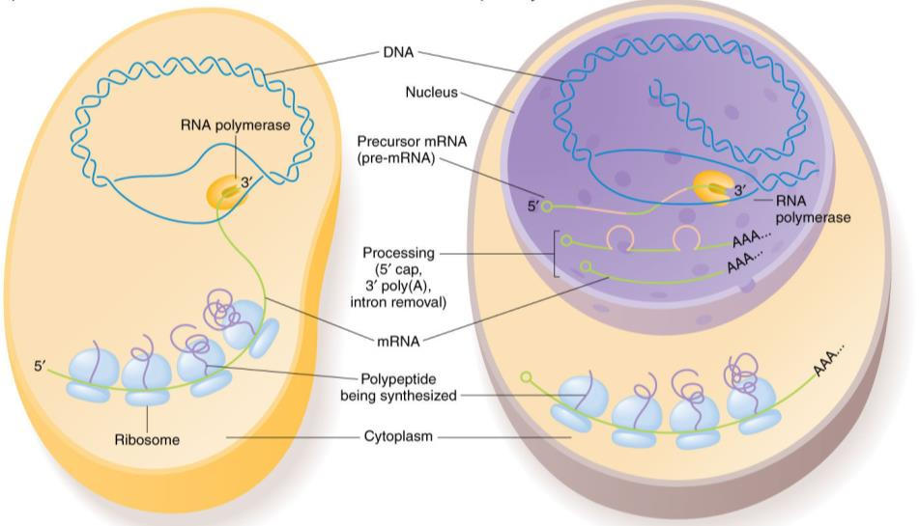
Transcription: At a Glance
Bacteria
Eukaryote

Slide 23
Regulation of Gene Expression
(Biological circuits)
0
1
1

Slide 24
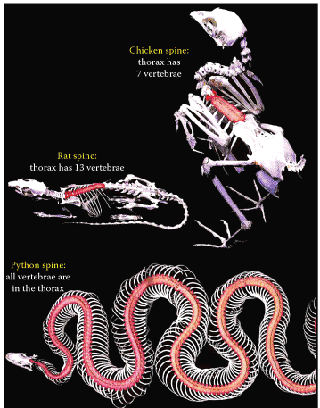
DNA: Contains the Instruction for Life
Hoxc8

Slide 25
Regulation of Gene Expression
Each cell contains all the genetic material for growth and development
Some of these genes are expressed all the time
Other genes are not expressed all the time. They are switched on an off at need

Slide 26
Lac Operon: A Classic Example of Bacterial Gene Expression Control
Operon: Cluster of genes, related by function, regulated by a single promoter and transcribed into one mRNA (polycistronic).
RNA Polymerase
mRNA
lacZ
lacY
lacA
promoter
Lac Operon
lacZ | β-galactosidase | Breaks lactose into galactose and glucose.
lacY | lactose permease | Imports lactose into the bacterial cell.
lacA | thiogalactoside transacetylase | Cell detoxification.

Slide 27
Functional Outcome of Lac Operon
RNA Polymerase
Transcription
lacZ
lacY
lacA
promoter
Ribosome
Thiogalactoside
transacetylase
Polycistronic
mRNA
lactose permease
β-galactosidase

Slide 28
Lac repressor is a negative regulator of the Lac operon
RNA Polymerase
Lac repressor
lacZ
lacY
lacA
Lac operator
Lac Operon
lacZ | β-galactosidase | Breaks lactose into galactose and glucose.
lacY | lactose permease | Imports lactose into the bacterial cell.
lacA | thiogalactoside transacetylase | Cell detoxification.

Slide 29
Lactose (Allolactose) Can Displace Lac Repressor From the Operator Site
RNA Polymerase
Lac repressor
lacZ
lacY
lacA
Lac operator
Lac Operon
Lac repressor
Lac repressor
Allolactose
(Inducer)
Lac operator
Lac operator

Slide 30
Four Possible Situations
Glucose | Lactose | Lac repressor bound | Lac operon
+ | - | YES | OFF (0)
+ | + | YES | OFF (0)
- | + | NO | ON (1)
- | - | YES | OFF (0)
RNA Polymerase
Lac repressor
lacZ
lacY
lacA
Lac pomoter
Lac operator
Lac Operon

Slide 31
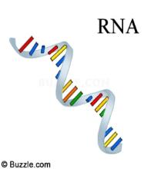

Translation
Translation
DNA
RNA
Protein
Polymer of nucleotides
Polymer of nucleotides
Polymer of amino acids

Slide 32
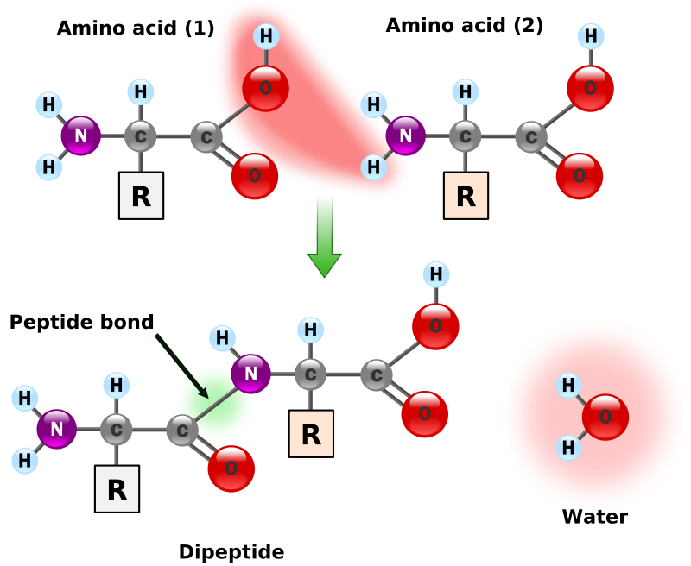
How Amino Acids are Linked Together
1
2
3
4
5
6
Polymer: Polypeptide and Protein
Monomers
(amino acids)
Peptide bonds

Slide 33
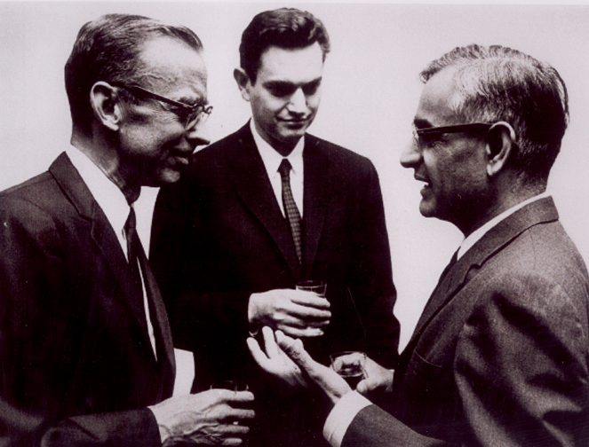
Genetic code
Genetic code is the relation between the sequence of bases in DNA (or its RNA transcripts) and the sequence of amino acids in proteins
A codon is a set of 3 nucleotides that specifies a particular amino acid
Why three nucleotides?
64 Codons present. Three of them (UAA, UAG, UGA) can’t code any amino acids, called STOP codons
AUG serves as the “initiator” or “start codon, which starts the synthesis of a protein
We have 61 codons that code for amino acids, and we have 20 amino acids. So, more than one codon may specify one particular amino acid
Khorana, Nirenberg, Holley
Nobel Prize in 1968
Notes:
A three-letter code is used because there are 20 different amino acids that are used to make proteins.
If a two-letter code were used there would not be enough codons to select all 20 amino acids.
That is, there are 4 bases in RNA, so 4² (4x 4)=16; where as for 3 lettered code the number is 4³ (4x4x4)=64.

Slide 34
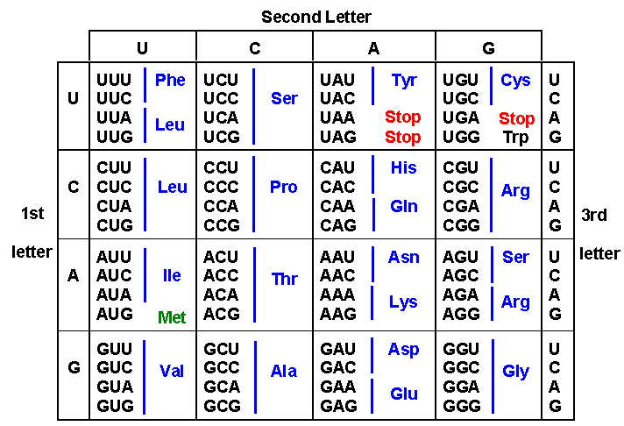
Genetic code
Don’t have to memorize!

Slide 35

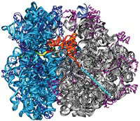
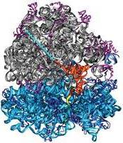
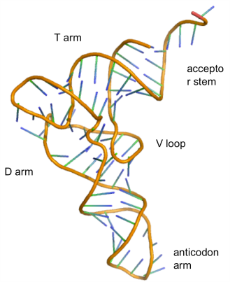
Translation
Venki Ramakrishnan, Thomas A. Steitz & Ada Yonath,
Nobel Prize 2009
Protein synthesizing machinery
Template for protein synthesis
5’
3’
mRNA
Ribosome: (rRNA + proteins)
5’UAAGGAGA
(RBS)
AUCGUCAUGAAGAGGCCC…….UAAUUA 3’
Start codon
Stop codon
30S
50S
Met─Lys─Arg─Pro……
Polypeptide
23S rRNA
5S rRNA
34 proteins
16S rRNA
21 proteins
Nascent polypeptide
5’UAAGGAGA
AUCGUCAUGAAGAGGCCC…….UAAUUA 3’
►In Eukaryotes, 5’ 7mG cap is recognized by ribosome
tRNA
Notes:
How does translation occur:
The ribosome is the protein synthesizing machinery of the cell
A macromolecular complex composed of multiple RNA and protein molecules
Two different subunits: the large subunit 50S and the small subunit 30S
The mRNA contains different regions in it, which defines the protein synthesis process.
The region that defines the protein sequence is known as reading frame
In the reading frame each set of three nucleotides in a sequential fashion define incorporation one particular amino acid
Each reading frame contains a start codon –AUG, from where ribosome begins the translation
AUG codes for Methionine, hence, all proteins has a methionine at the beginning
Subsequently, ribosome reads the down stream nucleotides in a set of three leading to the incorporation of specific amino acids in a highly precise manner
Translation stops when ribosome encounters one of the stop codons: UAA, UGA, UAG
mRNAs contain 3’ and 5’ untranslated regions (UTR’s) which does not code for protein sequence but plays important role in the translation process
Bacterial mRNA contains a ribosome binding site at the 5’UTR, which acts as a launching pad for ribosome
The tRNA molecules acts as an adaptor which reads the codon sequence and define incorporation of specific amino acids

Slide 36
Transfer RNA: the adapter molecule
tRNA
3D structure
2D structure
Notes:
The tRNA molecules of all the organism have highly conserved 3D structural arrangement – four stems and three loops
The center of the middle loop contains the anticodon, which is unique for each tRNA molecule and can base pair with the corresponding codon
The 3’-OH gets attached to a particular amino acid through an ester bond
Thus the tRNA molecule acts as an adapter between the codon and the corresponding amino acids

Slide 37
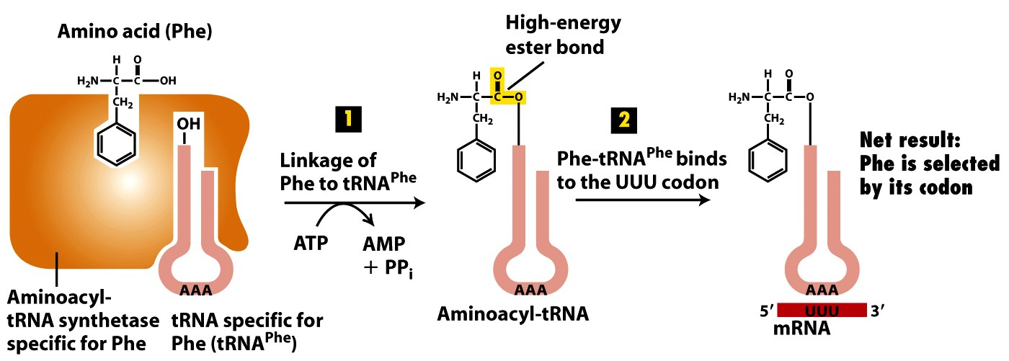
How Correct Amino Acids are Selected During Protein Synthesis
Notes:
There are specific enzymes which can interact with different tRNA and their corresponding amino acids and attach them together to form the aminoacyl tRNA molecule.
The reaction is energetically driven via hydrolysis of ATP to ADP
There are 20 different aminoacyl tRNA synthetase, each one can recognize one particular amino acids and its corresponding tRNA molecules to conjugate them

Slide 38
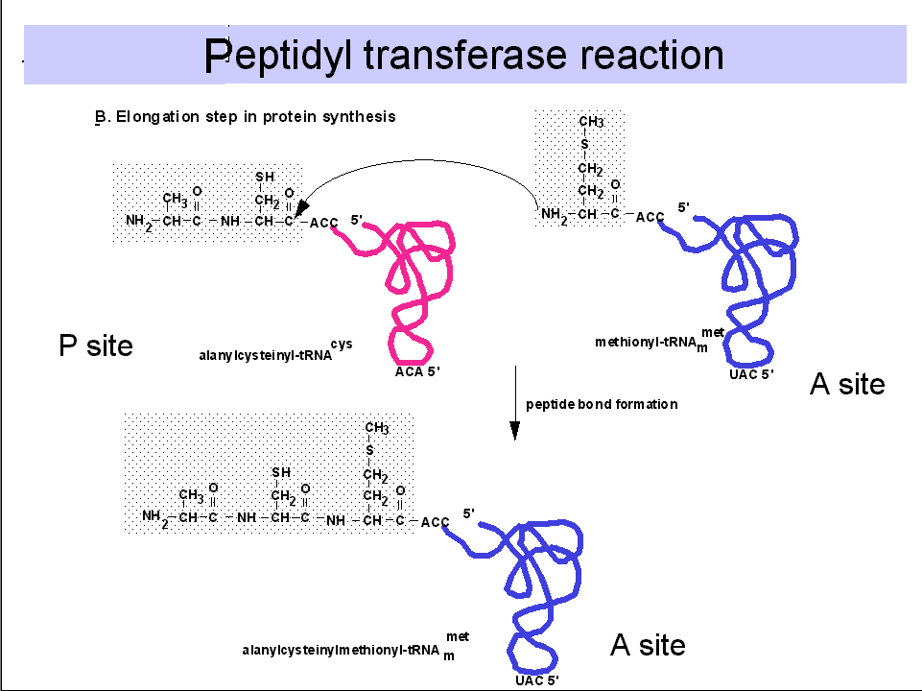
Peptidyl transferase reaction
Ala - Cys - Met
Met
Newly formed peptide bond
Ala - Cys
Nucleophilic attack
Peptide bond formation
ACA
UAC
ACA
UAC
UGU
AUG
UGU
AUG
Recycled

Slide 39
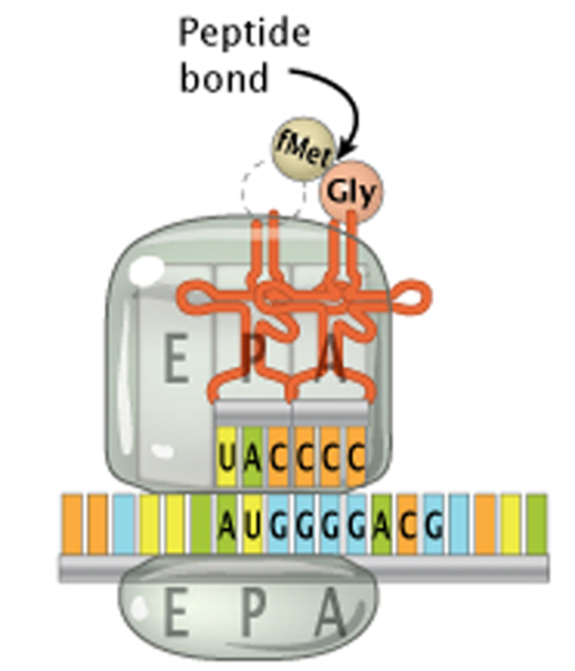
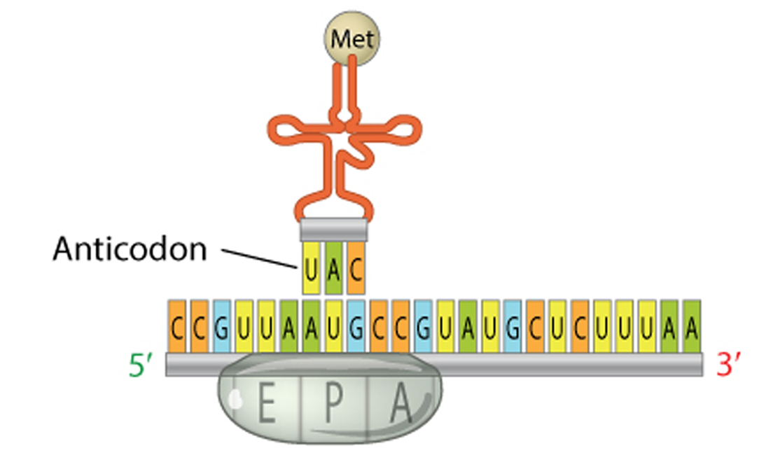
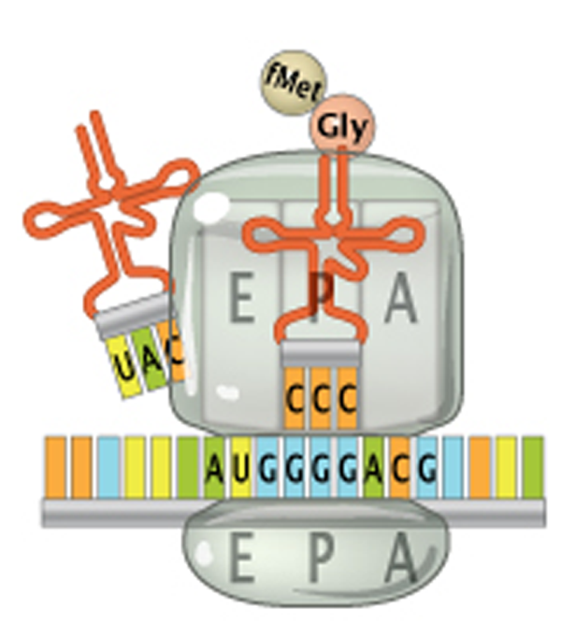
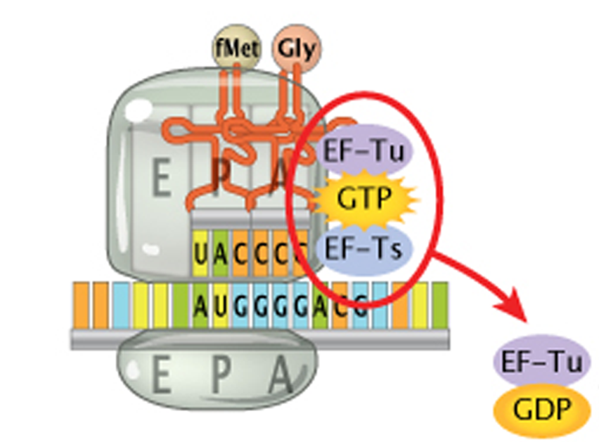
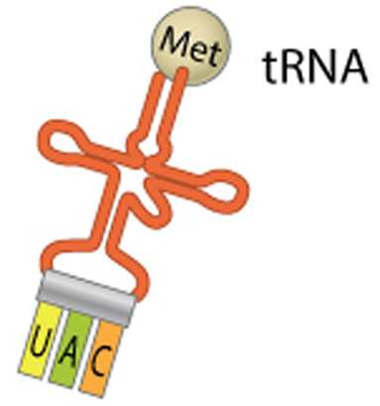
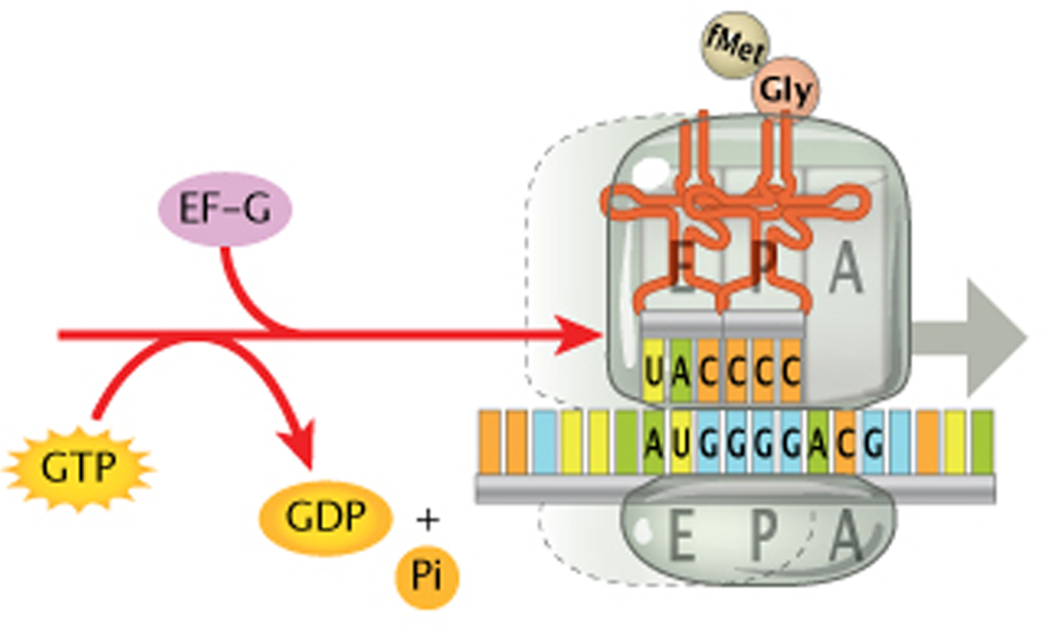
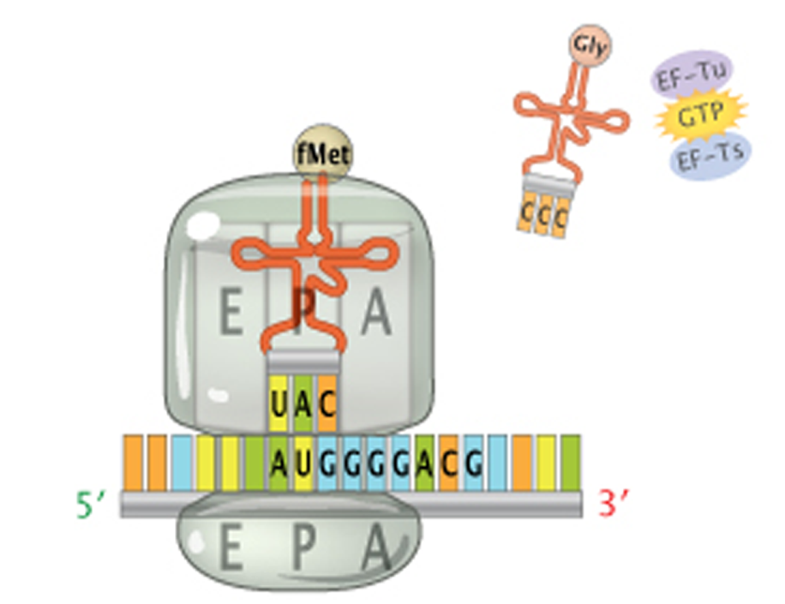
Translation: Involved Machineries and Processes
mRNA
Ribosome
Amino acid
tRNA
mRNA
30S ribosome
50S ribosome
Next charged tRNA and associated translation factors enter the A site
tRNA^{fMet} occupies the P site of the ribosome
The ribosome moves down the mRNA to the next codon and the uncharged tRNA now in the E site
E site tRNA releases and A site is now ready to receive another tRNA
Peptide bond forms between the aa in the P and A sites, and the tRNA in the P site releases its aa
Notes:
Steps of translation:
First the aminoacyl tRNA, containing the Methionine to its 3’-end, complexes with the small subunit of the ribosome to form the pre-initiation complex.
This pre-initiation complex then gets recruited to the mRNA with the help of translation initiation factors
Once placed on the mRNA, the pre-initiation complex then scans down the mRNA sequence, looking for the start codon.
As the tRNA anticodon binds the start codon, the large subunit of the ribosome gets attached to the pre-initiation complex to complete the formation of active ribosome complex
In this complete ribosome, the initiating tRNA^{MET} binds to a precise site location, denoted as P site.
Next, different elongation factors brings the second aminoacyl tRNA to the A site of the ribosome where the anticodon of this tRNA can base pair with the second codon
A peptide bond is formed between the amino group of the amino acid positioned in A site and the ester group of the other positioned in the P site
This results in the release of the tRNA in the P site from its amino acid
The ribosome then moves down the mRNA to the next codon resulting the shifting of the 1st tRNA from P to E site (from which it can be release for further recycling), 2nd tRNA from A to P site and leaving the A site empty for accepting new aminoacyl tRNA.
This process continues until ribosome encounters the stop codon
The stop codon does not gets recognized by any tRNA, but a termination factor which dismantle the entire machinery to get recycled again

Slide 40
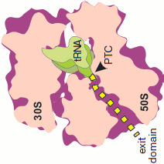
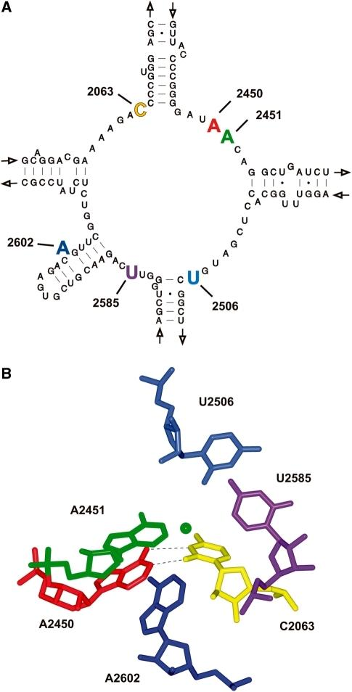
What Happens Inside the Ribosome? Chemical and Physical Consideration of Protein Synthesis
Peptidyl transferase center
Notes:
The primary enzymatic activity of the ribosome is the peptidyl transferase activity, which is formation of peptide bonds between adjacent amino acids attached to the tRNA (i.e., aminoacyl tRNAs).
Peptidyl transferase activity is carried out by ribosomal RNA (rRNA), a ribozyme, and not by any ribosome associated proteins. Ribozymes are the only enzymes which are not made up of proteins, but ribonucleotides.
The multicolored nucleotides in the RNA structure are the most important one for the enzymatic activity

Slide 41
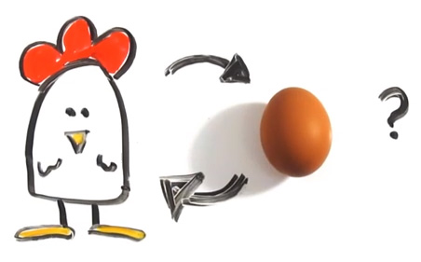

Which Came First? Nucleic acids or Proteins
DNA Polymerase
RNA Polymerase
Ribosome
DNA
RNA
Protein
Transcription
Translation
Replication
►RNA has enzymatic activity

Slide 42
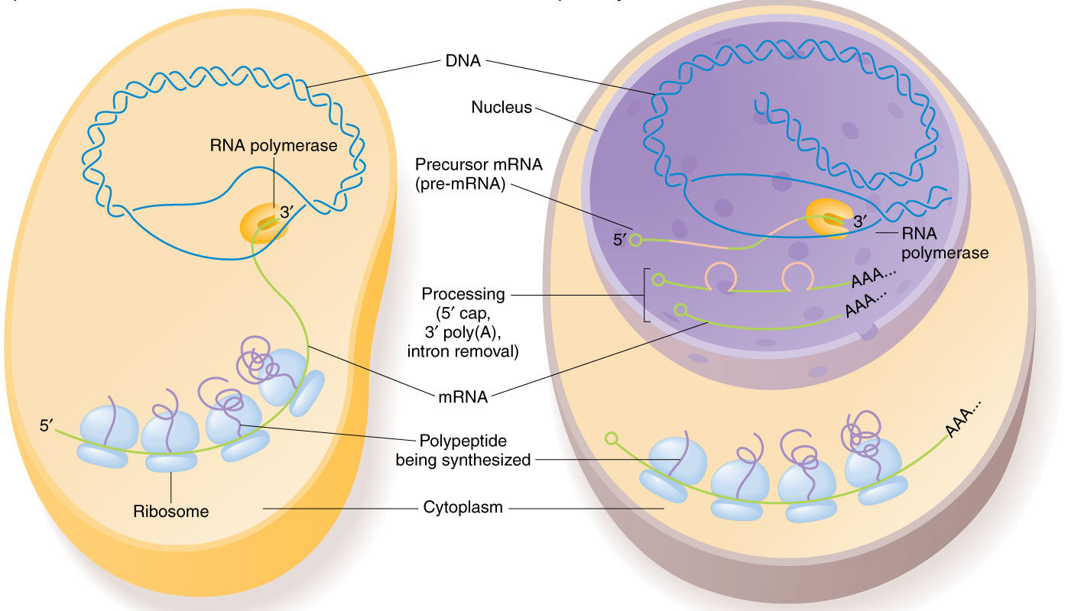
Transcription & Translation is coupled for prokaryotes
Bacteria
Eukaryote

Slide 43
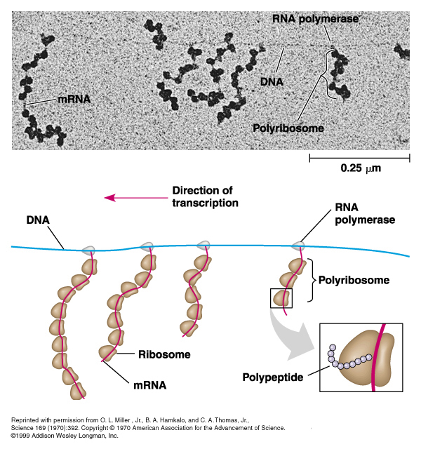
Time, Space and Correlation between Transcription and Translation

Slide 44
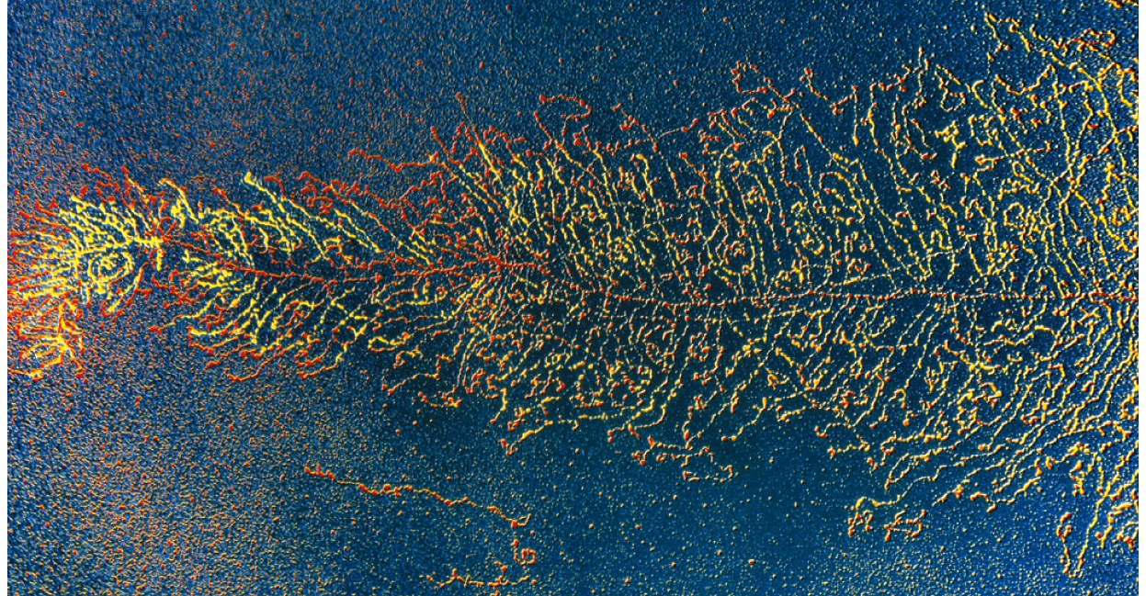
Overview of Transcription and Translation

Slide 45
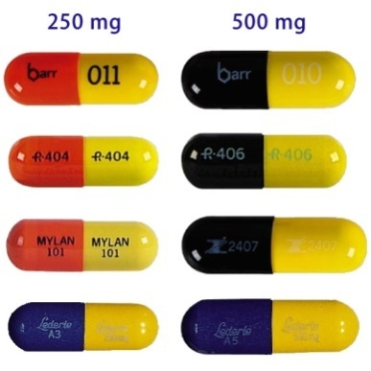



Translation Machineries: Attractive Targets For Therapeutics
Tetracycline
Chloramphenicol
Binds to the 30S ribosome, and blocks binding of aminoacyl-tRNA to the A-site
Blocks the peptidyl transferase reaction on 50S ribosomes
Streptomycin | Binds to the 30S ribosome, prevents the transition from initiation to chain-elongation
Erythromycin | Binds to the 50S ribosome, and blocks the translocation

Slide 46

Different genetic events: At a Glance

Slide 47


Suggested Textbook…
Stryer…
Baltimore, Lodish..

Slide 48

Extra Resources
Further Reading...
Videos…
mRNA synthesis (Transcription)
http://highered.mheducation.com/sites/0072507470/student_view0/chapter3/animation__mrna_synthesis__transcription___quiz_2_.html
Protein synthesis (Translation)
https://www.youtube.com/watch?v=Ikq9AcBcohA
Overview
https://www.youtube.com/watch?v=gG7uCskUOrA
James Darnell

